Slide 1
Na Und?
The Game of Choice

Slide 2
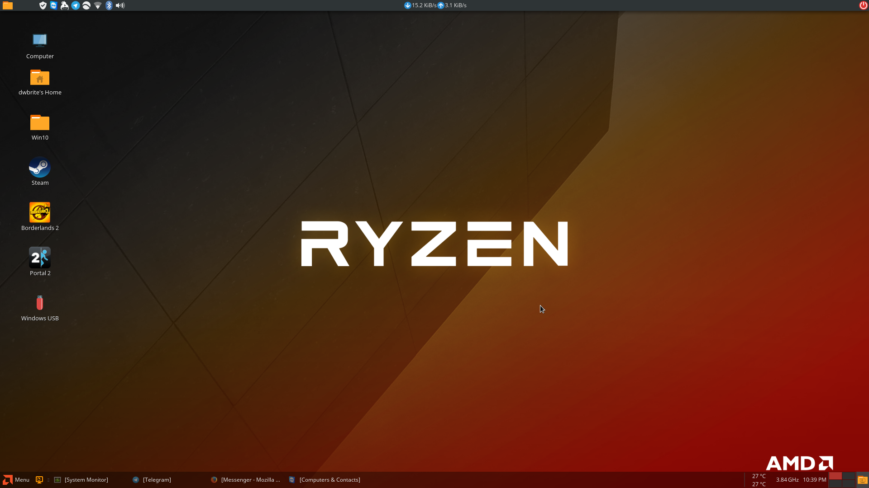
Themes
Art
Politics
Unreality

